Slide 1
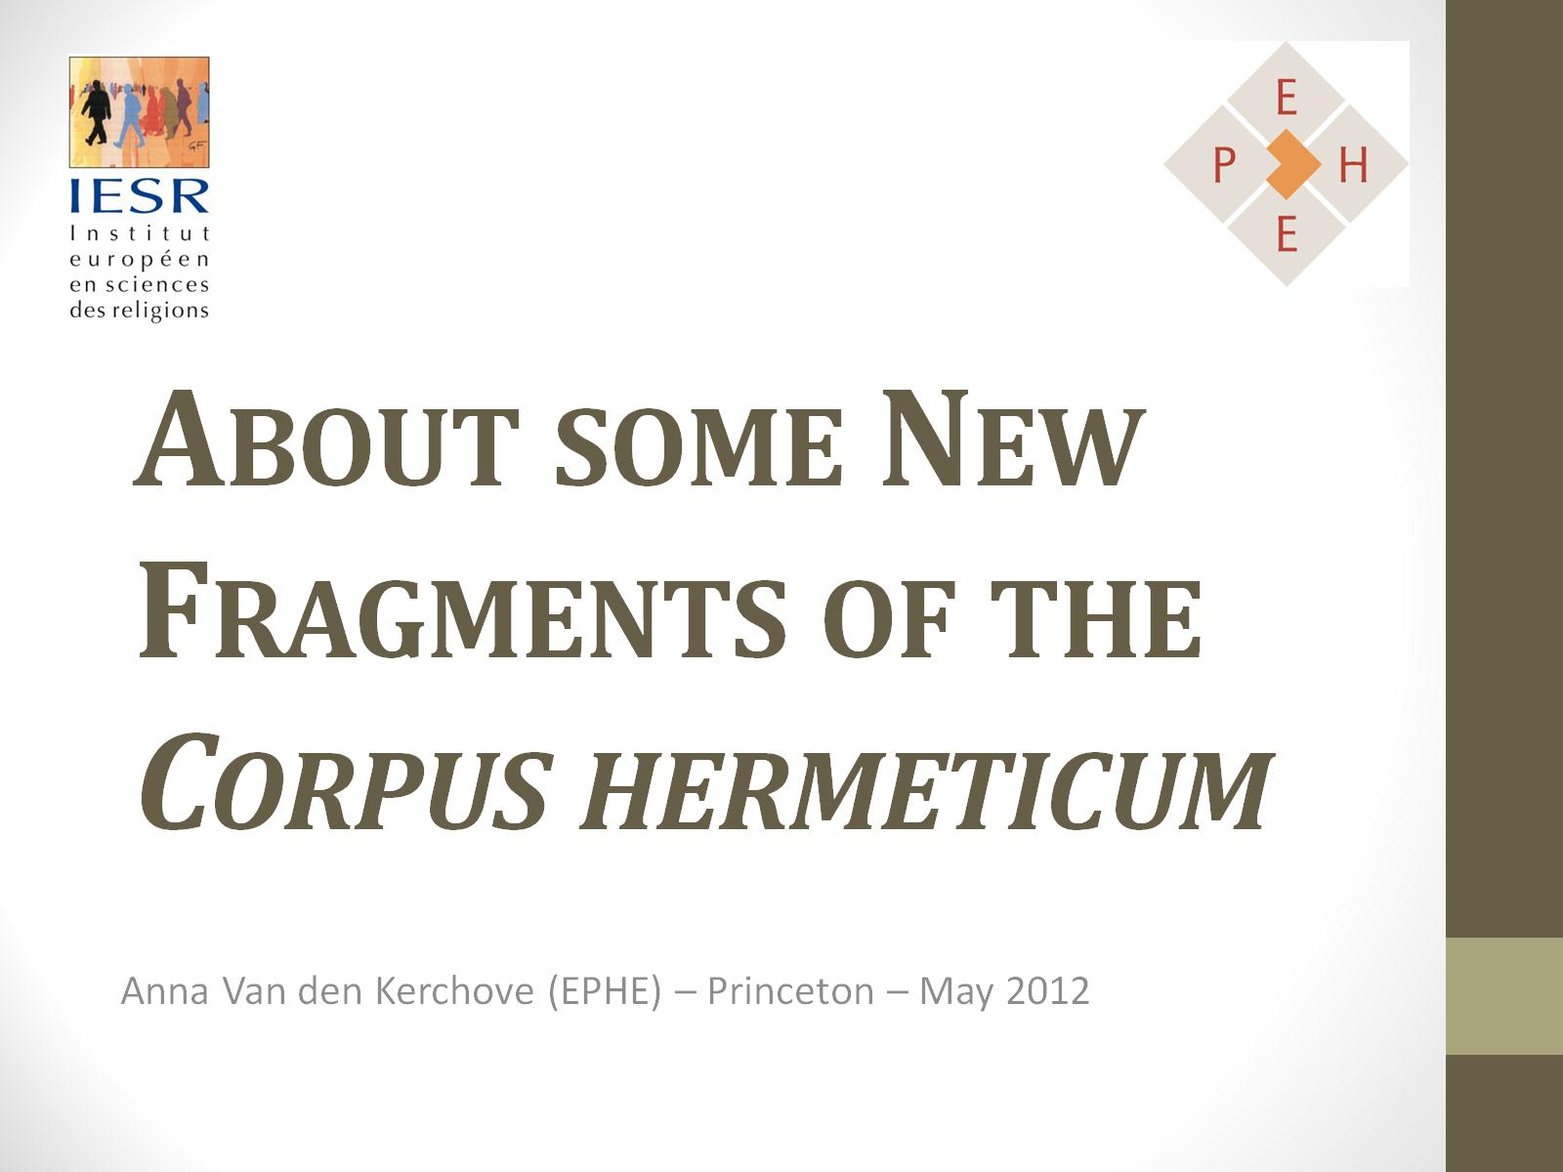
About some New Fragments of the Corpus hermeticum

Slide 2
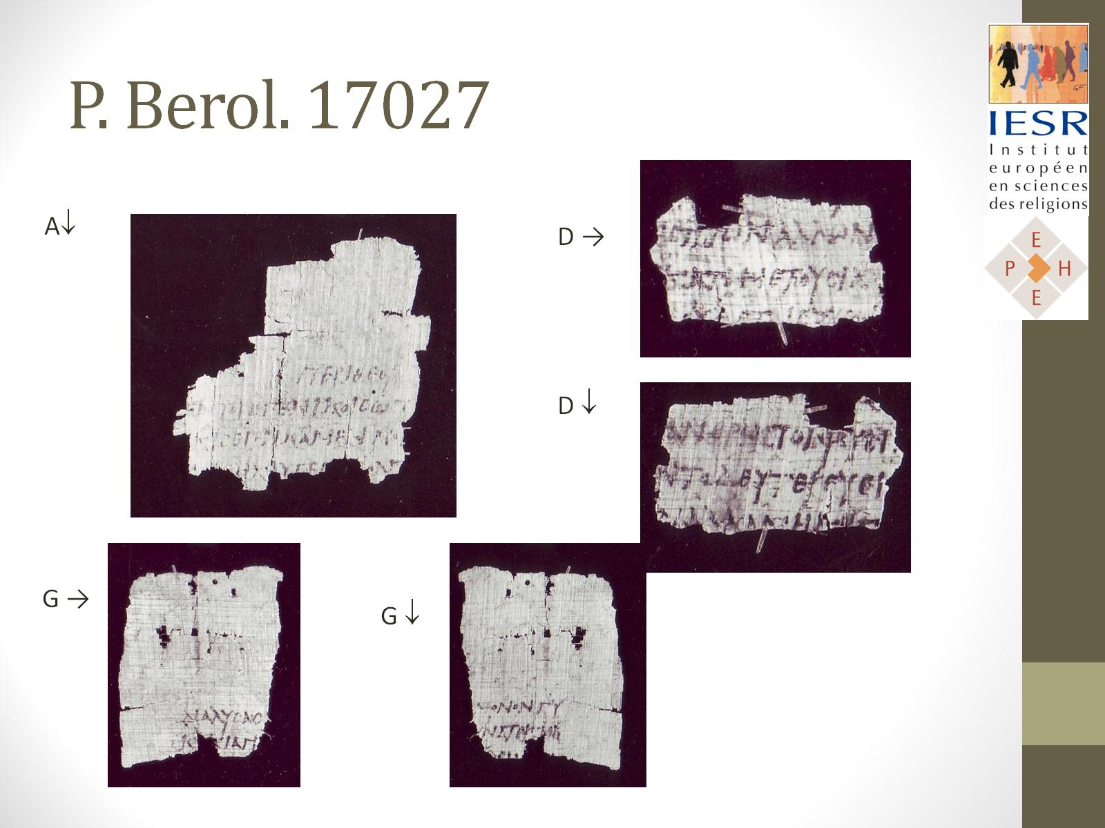
P. Berol. 17027

Slide 3
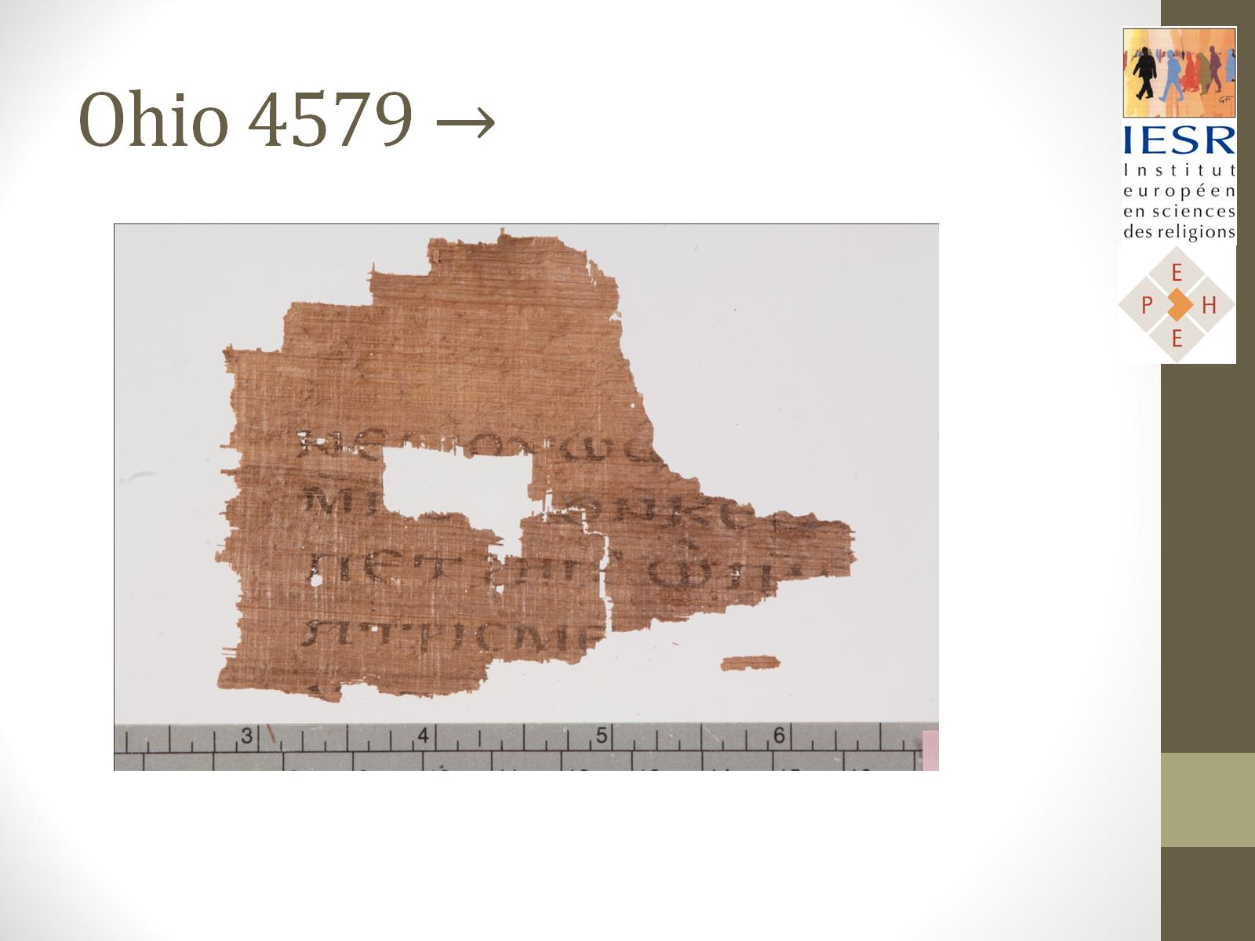
Ohio 4579 →

Slide 4
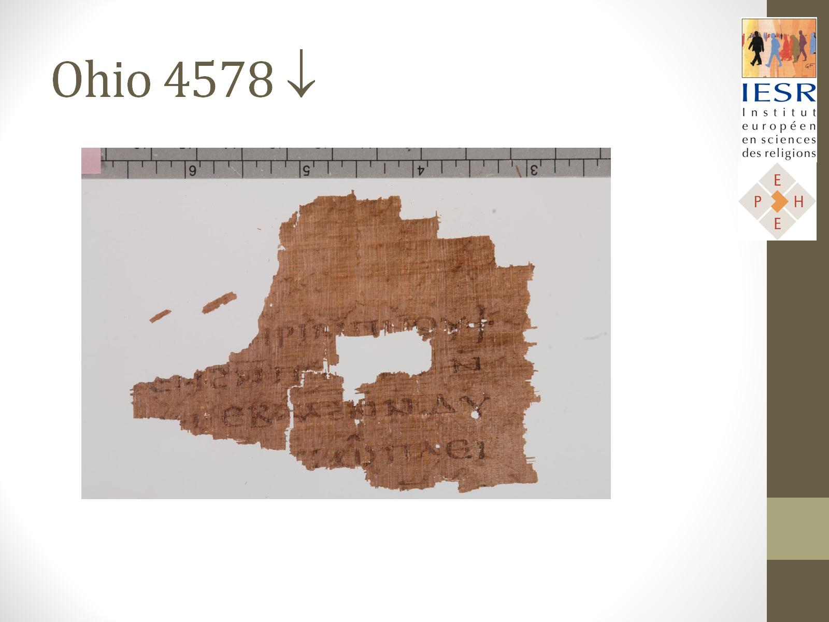
Ohio 4578 ↓

Slide 5
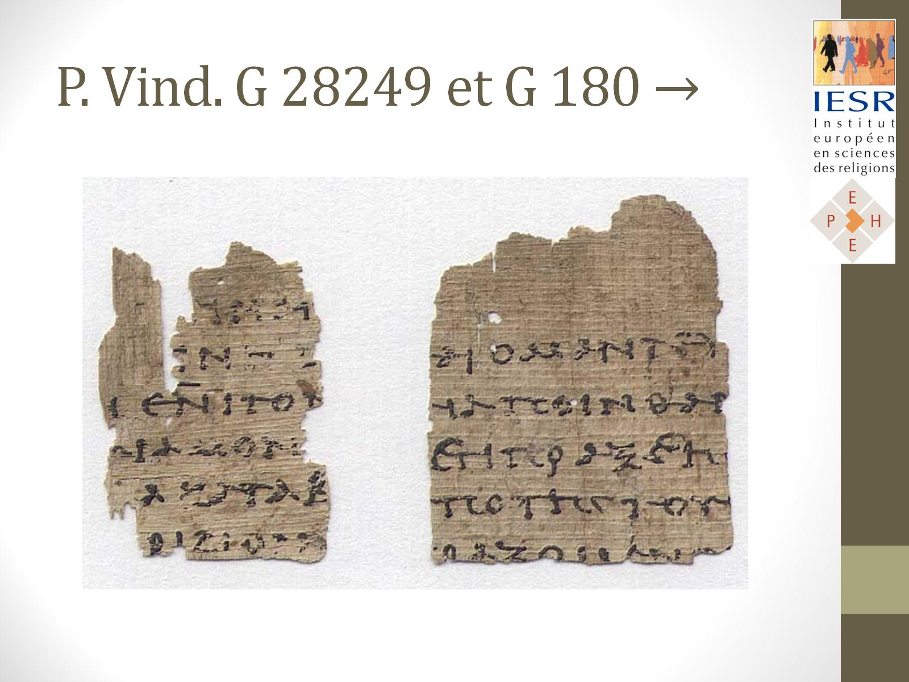
P. Vind. G 28249 et G 180 →

Slide 6
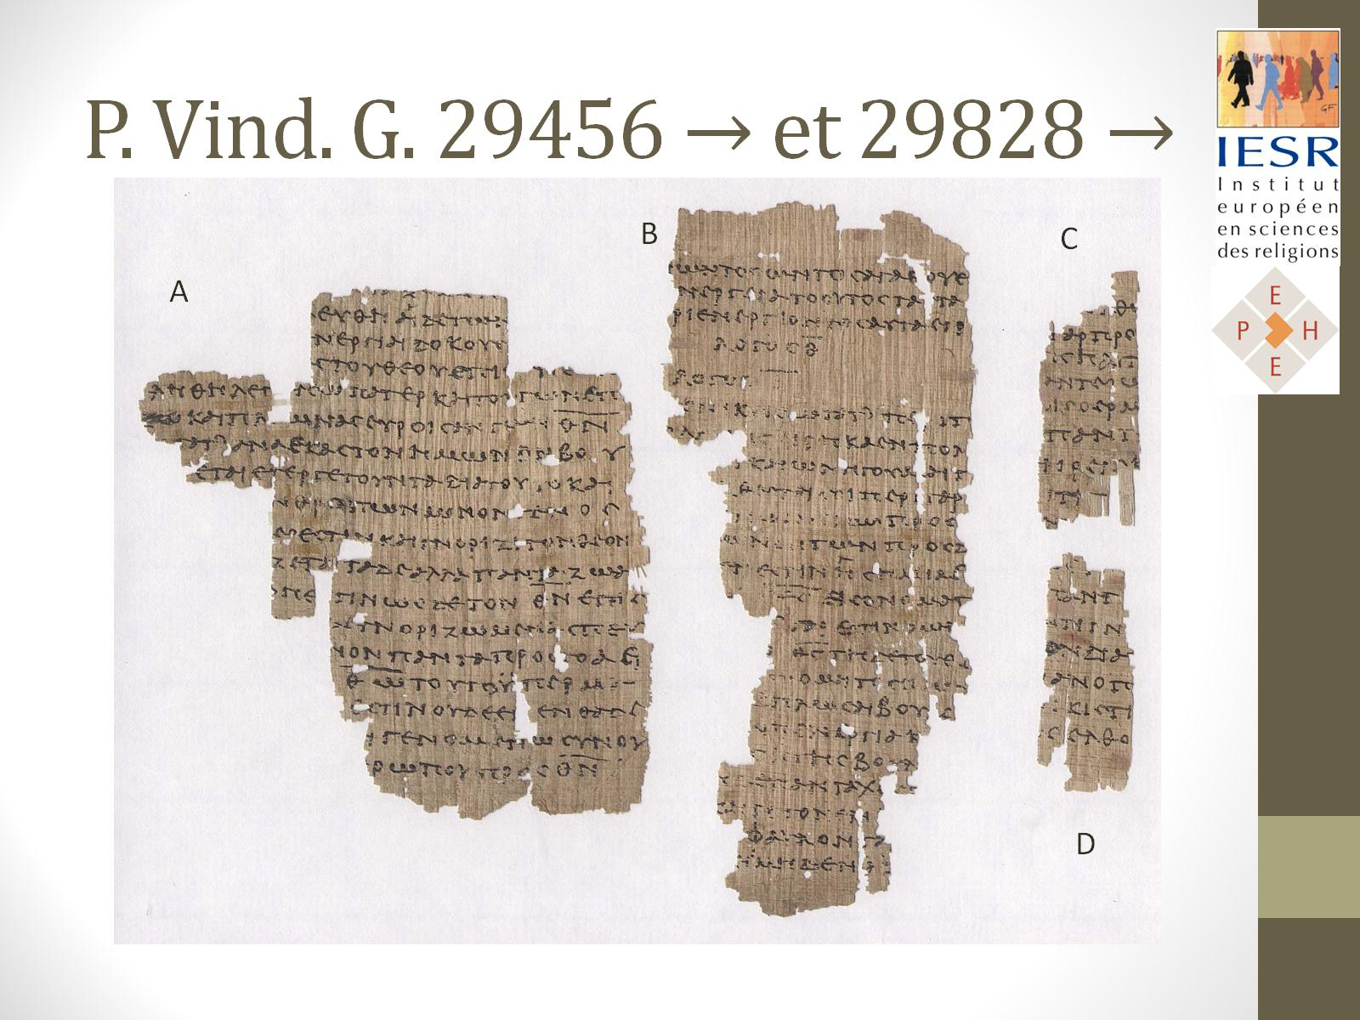
P. Vind. G. 29456 → et 29828 →

Slide 7
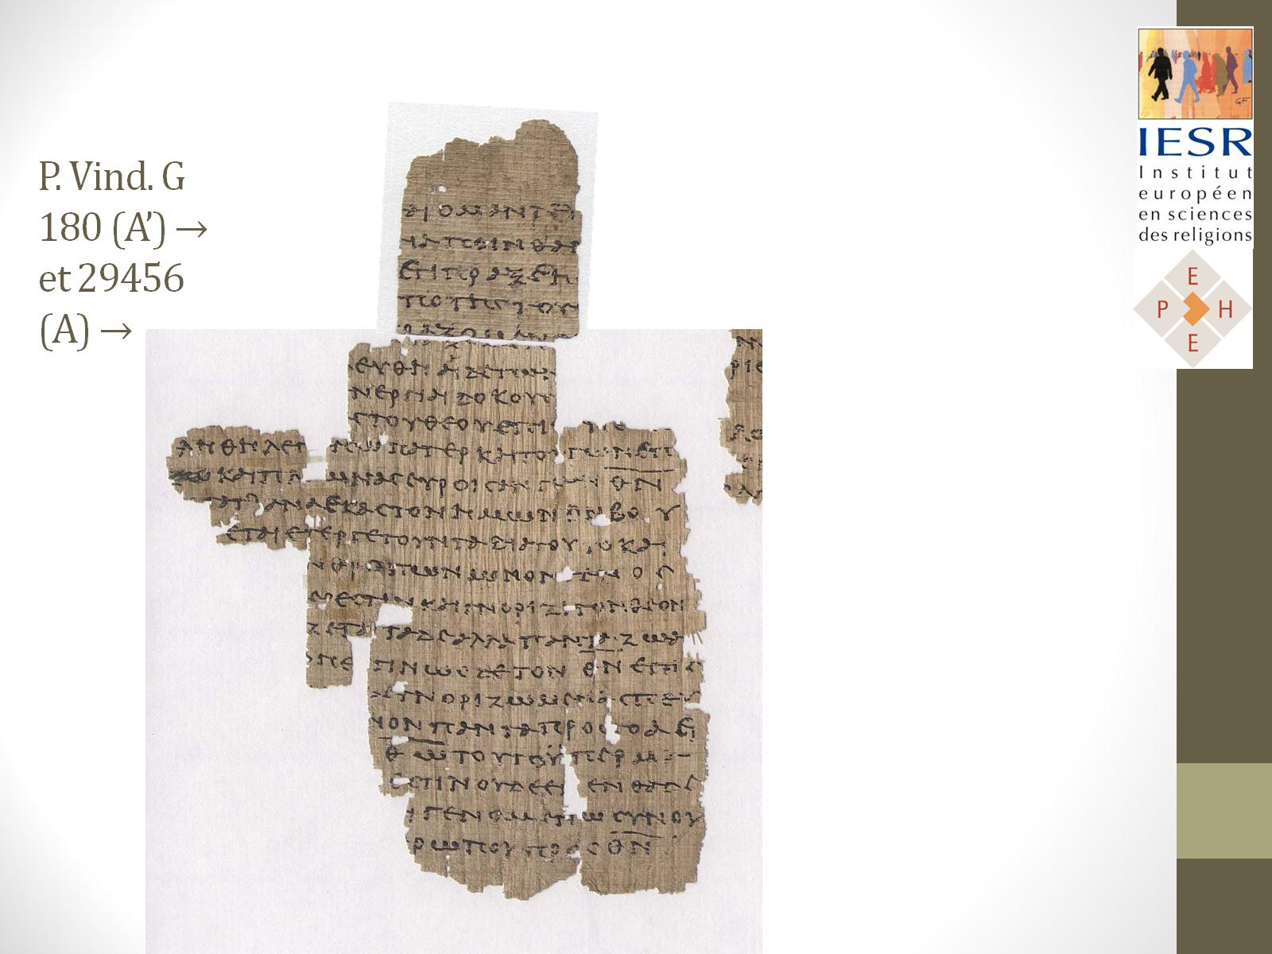
P. Vind. G 180 (A’) → et 29456 (A) →

Slide 8
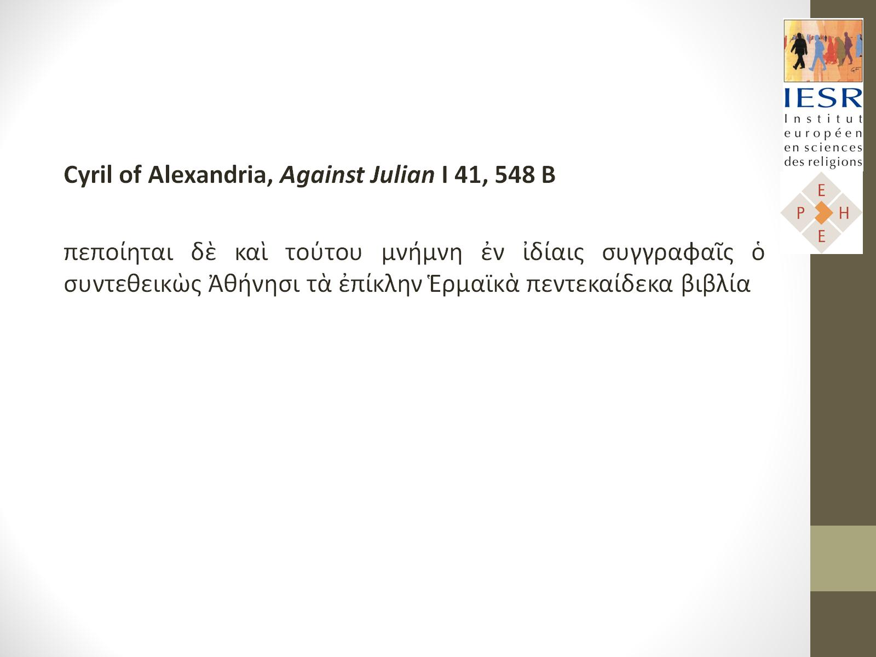

Slide 9
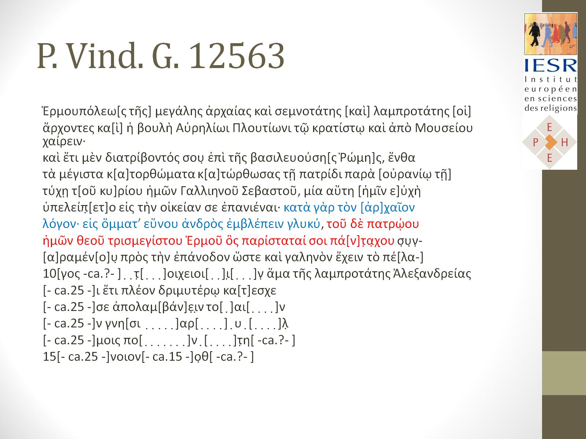
P. Vind. G. 12563

